Slide 1
Gastroparesis
Dr Abdullahi Hadi
Physician and Gastroenterologist
GSK Symposium May 2025

Slide 2
Definition
Gastroparesis is a motility disorder of the stomach
characterized by symptoms suggesting retention of food in the stomach
objective evidence of delayed gastric emptying
absence of mechanical obstruction in the gastric outflow
excluded by radiology and/or endoscopy.
Epidemiology:
9.6 per 100,000 (men)
38 per 100,000 (women)
Jung et al Gastroenterology 2009
Parkman et al Gastroenterology 2004
Shankar et al Current Gastroenterology Reports 2021

Slide 3
Etiology
Idiopathic (40%), Post-viral syndrome, women, associated depression and anxiety.
diabetes (37.5%), Type I - 5%, Type II – 1%
Post Surgical (13%), Vagotomy, Bariatric, Fundoplication..
drug induced (opioids, analgesia, GLP-1 agonists, amylin agonists, CCB, anticholinergics),
Parkinson’s, MS, CP, SLE, Scleroderma.
Ye et al Gastroenterology 2022

Slide 4

Cardinal symptoms
Nausea (>90%),
vomiting (84%),
early satiety (60%),
post prandial fullness,
belching,
bloating,
upper abdominal pain,
weight loss,
malnutrition, and dehydration.
Timing of the symptoms?
Pasricha et al Gastroenterol Hepatol 2022

Slide 5
Pathophysiology
Not well understood, various pathways proposed.
Loss of fundal accommodation secondary to loss of Vagus nerve inhibition due to chronic hyperglycemia.
Loss of Interstitial cells of Cajal (pacemaker of gastric motility) post viral infection.
Loss of hormones that augment gastric motility (motilin, gelatin and pancreatic enzymes).
Pylorospasm.
Gastric arrythmias.
Autonomic neuropathy.
Poor correlation between degree of delay and symptom severity.
Ward gut 2002
Liu et al Gut Liver 2017

Slide 6
Diagnosis
Standard test for evaluation is gastric scintigraphy of solids.
Protocol: 4 imaging protocol with scans taken at 0,1,2 and 4 hours after ingestion of radioactive technetium with solid food.
Delayed gastric emptying is defined: greater than 60% retention at 2 hours post prandially and or greater than 10% retention at 4 hours.
Four hour post prandial test is the most recommended time to obtain results.
Patients should be euglycemic during the study.
These drugs should be stopped 48 hours before study (opioids, cannabinoids, prokinetics, antiemetics, neuromodulators, GLP-1 agonists).
Standardized meal: solid meal eggs, two slices of white toast, strawberry jelly, and 120ml of water.
Upped endoscopy to exclude mechanical obstruction. Full thickness biopsy.
Other tests: wireless motility capsule, Endo flip, Pan GI scintigraphy, C-13 labeled breath test

Slide 7
Gastroparesis Spectrum
Severity of Disease:
Mild symptoms - Easily controlled by diet
Severe symptoms - Inability to maintain nutrition - Life threatening
Gastroparesis Cardinal Symptom Index Daily Diary

Slide 8
Management
Dietary management
Medication
Behavioral modification/psychiatric treatment.
Surgery
Unfortunetly there is no cure for gastroparesis
Goal of treatment: Symptom control and quality of life

Slide 9

Dietary management
Low fat
Low Fiber
Small frequent Meals
Liquid supplementation
Multivitamin (liquid/cheweble).

Slide 10

Management
Correct underlying condition: Review medications, glycemic control for diabetics
Hydration and nutrition
NG tube feeding

Slide 11
Prokinetics
Metoclopramide
Domperidone
Erthromycin
Cisapride

Slide 12
Erythromycin
Ideal dose is 1-2mg/kg per dose
Mostly for diabetic GP
Tachyphylaxis is common and expected. (drug holiday)

Slide 13
Antiemetics
Promethazine
Ondasetron
Prochloreperazine
Prucalopride

Slide 14
Minimally invasive
Botox
Pneumatic balloon dilatation
Stenting

Slide 15

Pyloric Botox
Several retrospective studies have shown clinical benefit in short-term in 5-77% symptomatic improvement.
However, two randomized placebo-controlled studies have not shown its superiority over placebo injection either at a dose of 100 or 200 IU.
ESGE does not recommend BOTOX.
Arts et al Aliment Pharmacol 2007
Wuesten et al Endoscopy 2020
Friedenburg el al Am J Gastroent 2008

Slide 16
Gastric Electrical Stimulation
>30 studies published to date, only 6 are blinded.
Study size: 5-214 (mostly 18-33), Most mixed (DM and idiopathic)
Improves N&V in 50% of patients
Some improvement in glycemic control
Not helpful for pain or bloating
No improvement on GES
Maranki et al Dig Dis Sci 2008

Slide 17
Invasive
Pyloroplasty
Pyloromyotomy
Jejunal tube
Partial gastric resection
Total gastrectomy

Slide 18
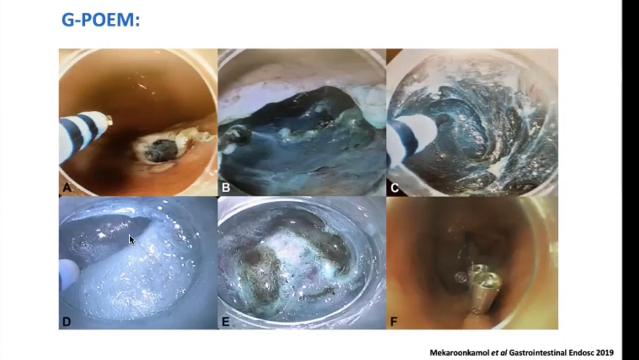

Slide 19
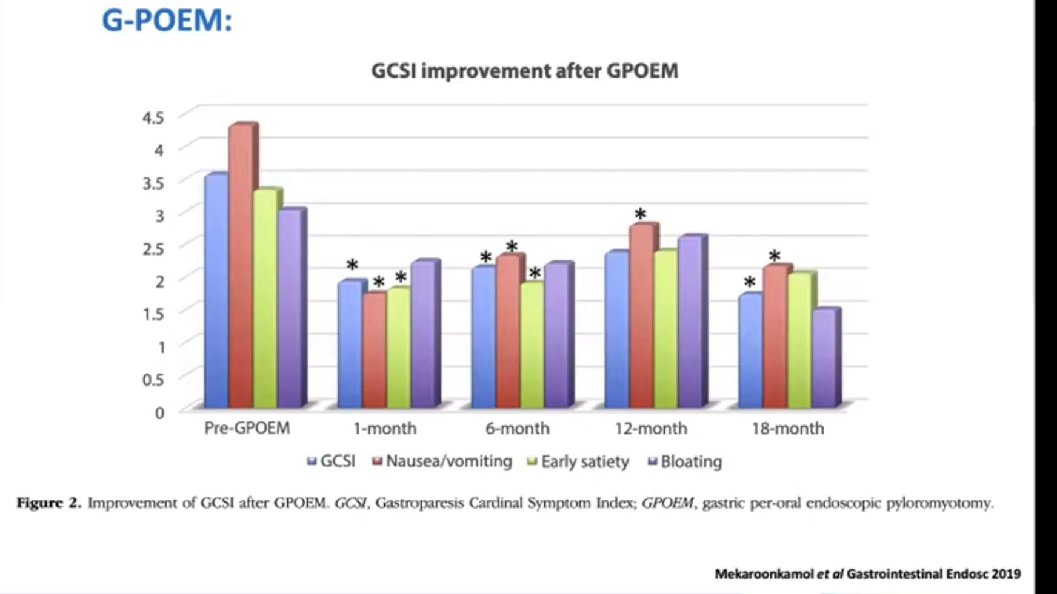

Slide 20
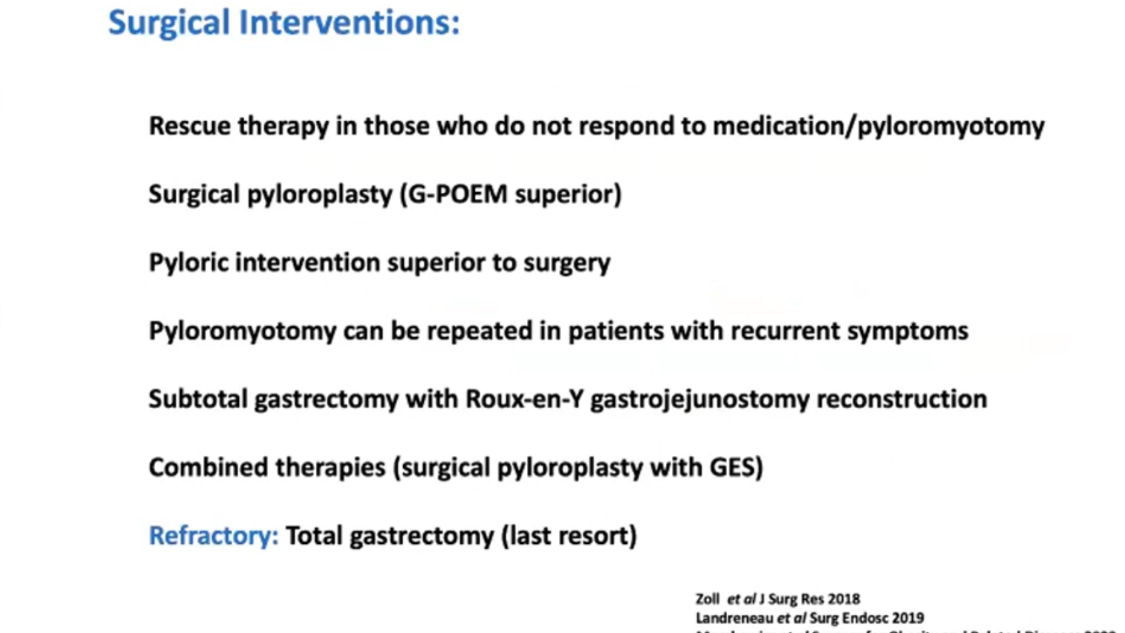

Slide 21
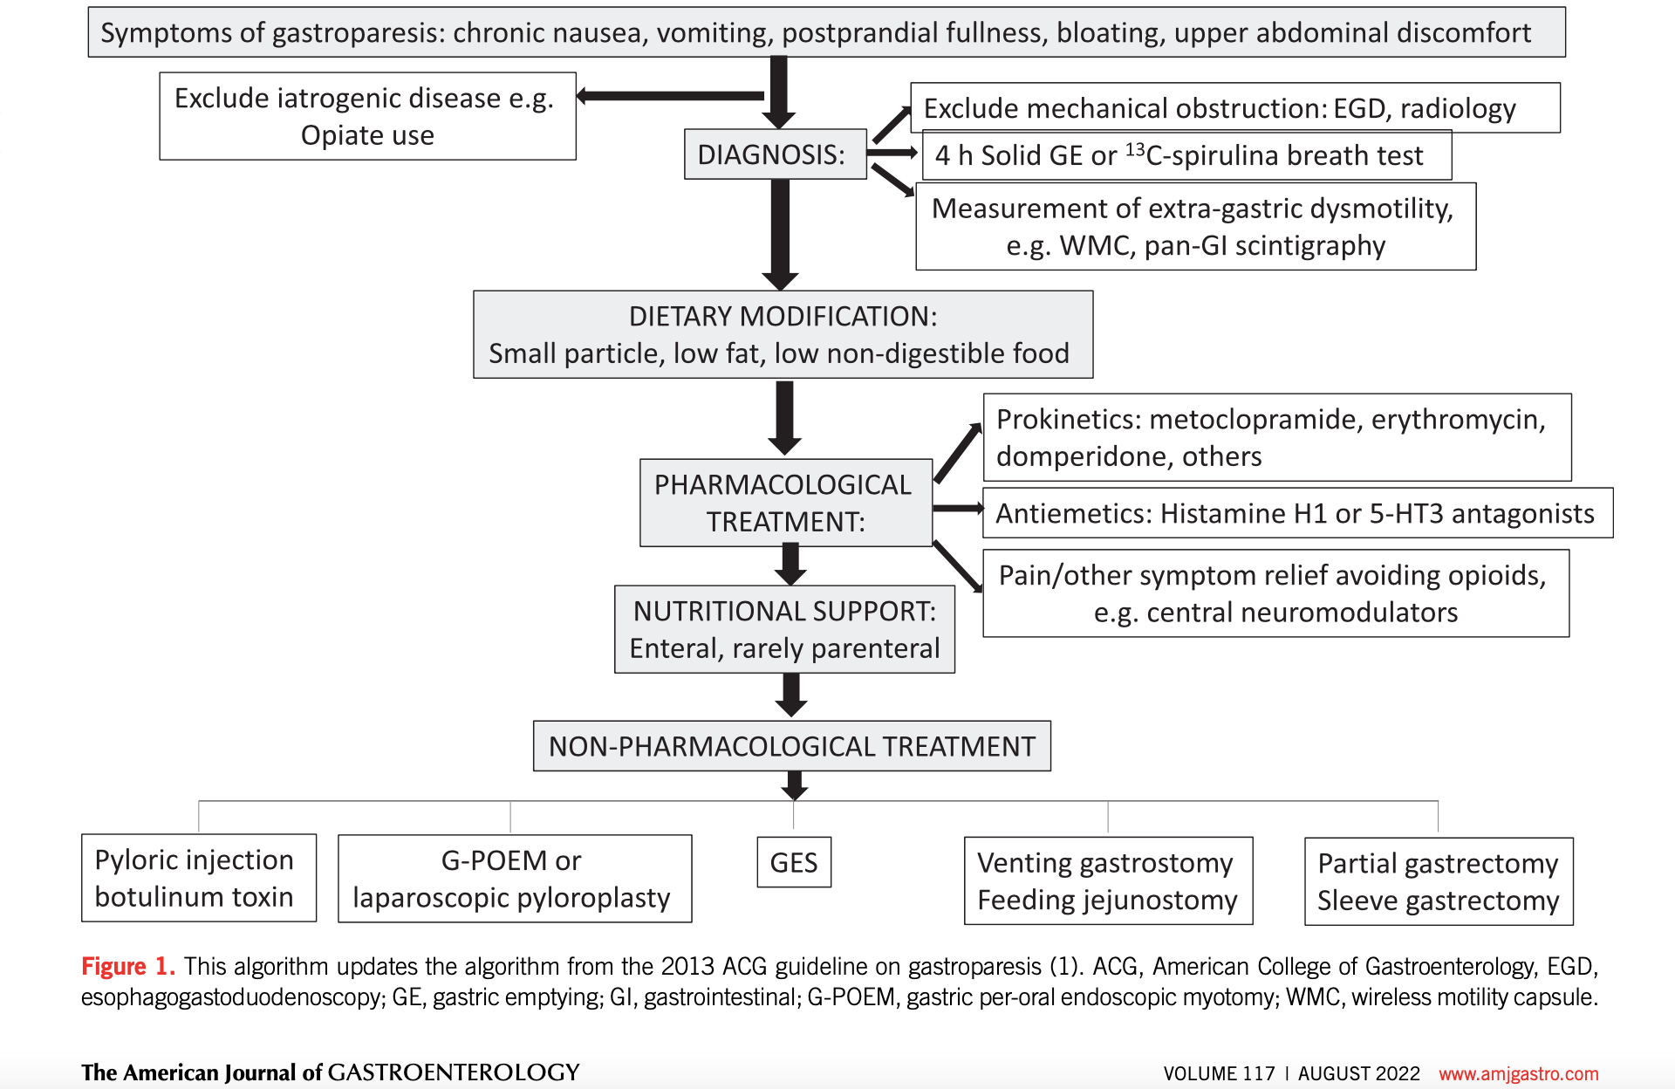

Slide 22

Thank you

